Slide 1
PC^2 Web Team Interface (WTI)
Sprint 2 Review
Josie Isaacson, Andrew Combs, Ethan Holman, Danielle Frodge

Slide 2
DevOps User Stories

Slide 3

Done in Sprint 2
Final mockups complete and uploaded to repo
SRS updated with final mockups
Code for login feature complete (not tested) for both frontend (Angular) and backend (Java)
Upcoming Sprint 3
Finish connecting login feature with ui and api
Start on:
Websocket connection
Logoff endpoint
Contest languages endpoint
Finish testing login feature
UI design components such as footers, tables, etc.

Slide 4
Final Mockups

Slide 5
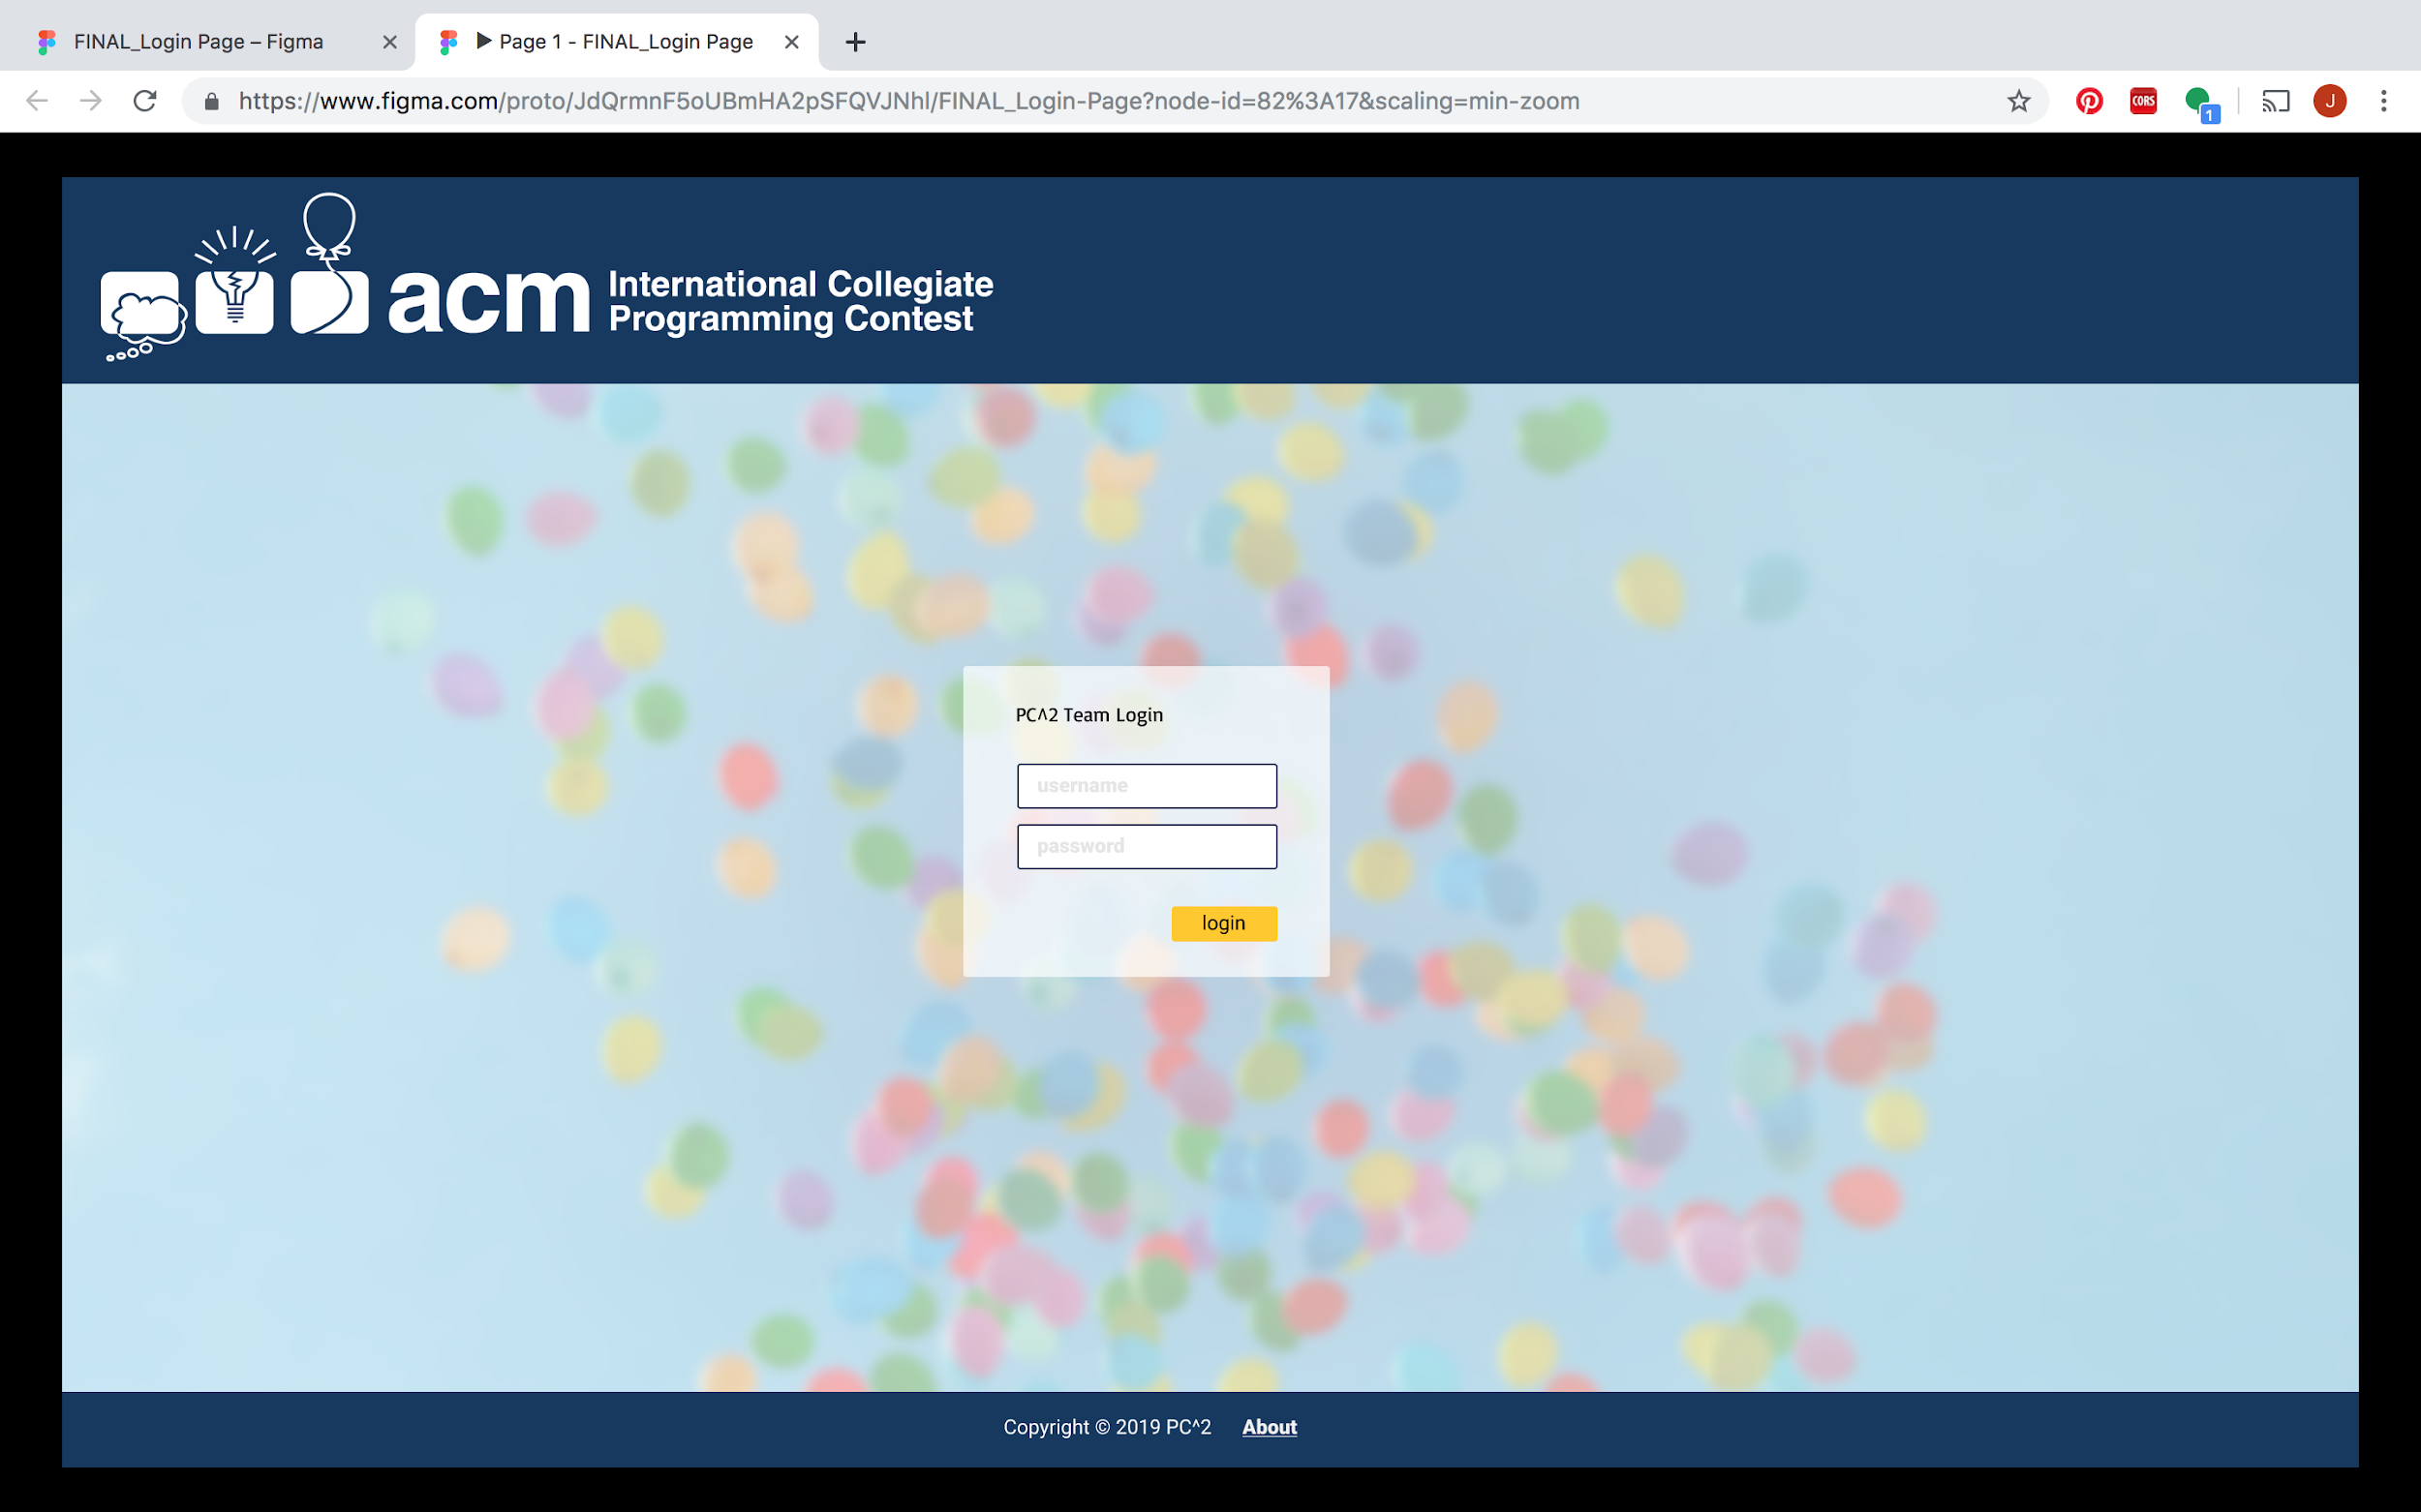

Slide 6
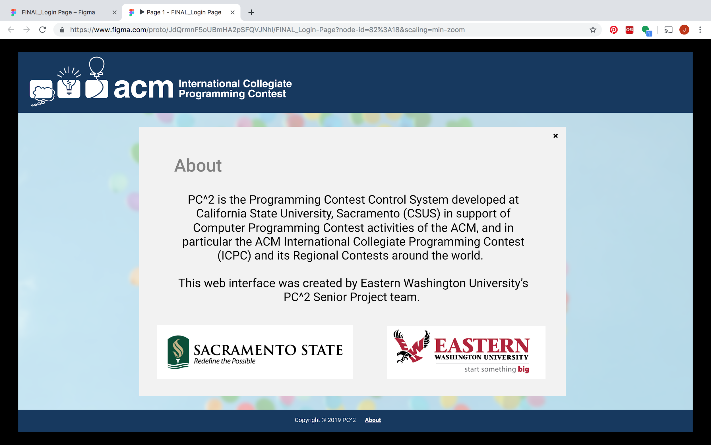

Slide 7
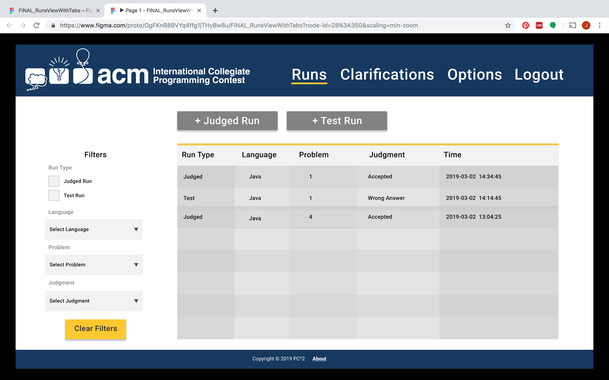

Slide 8
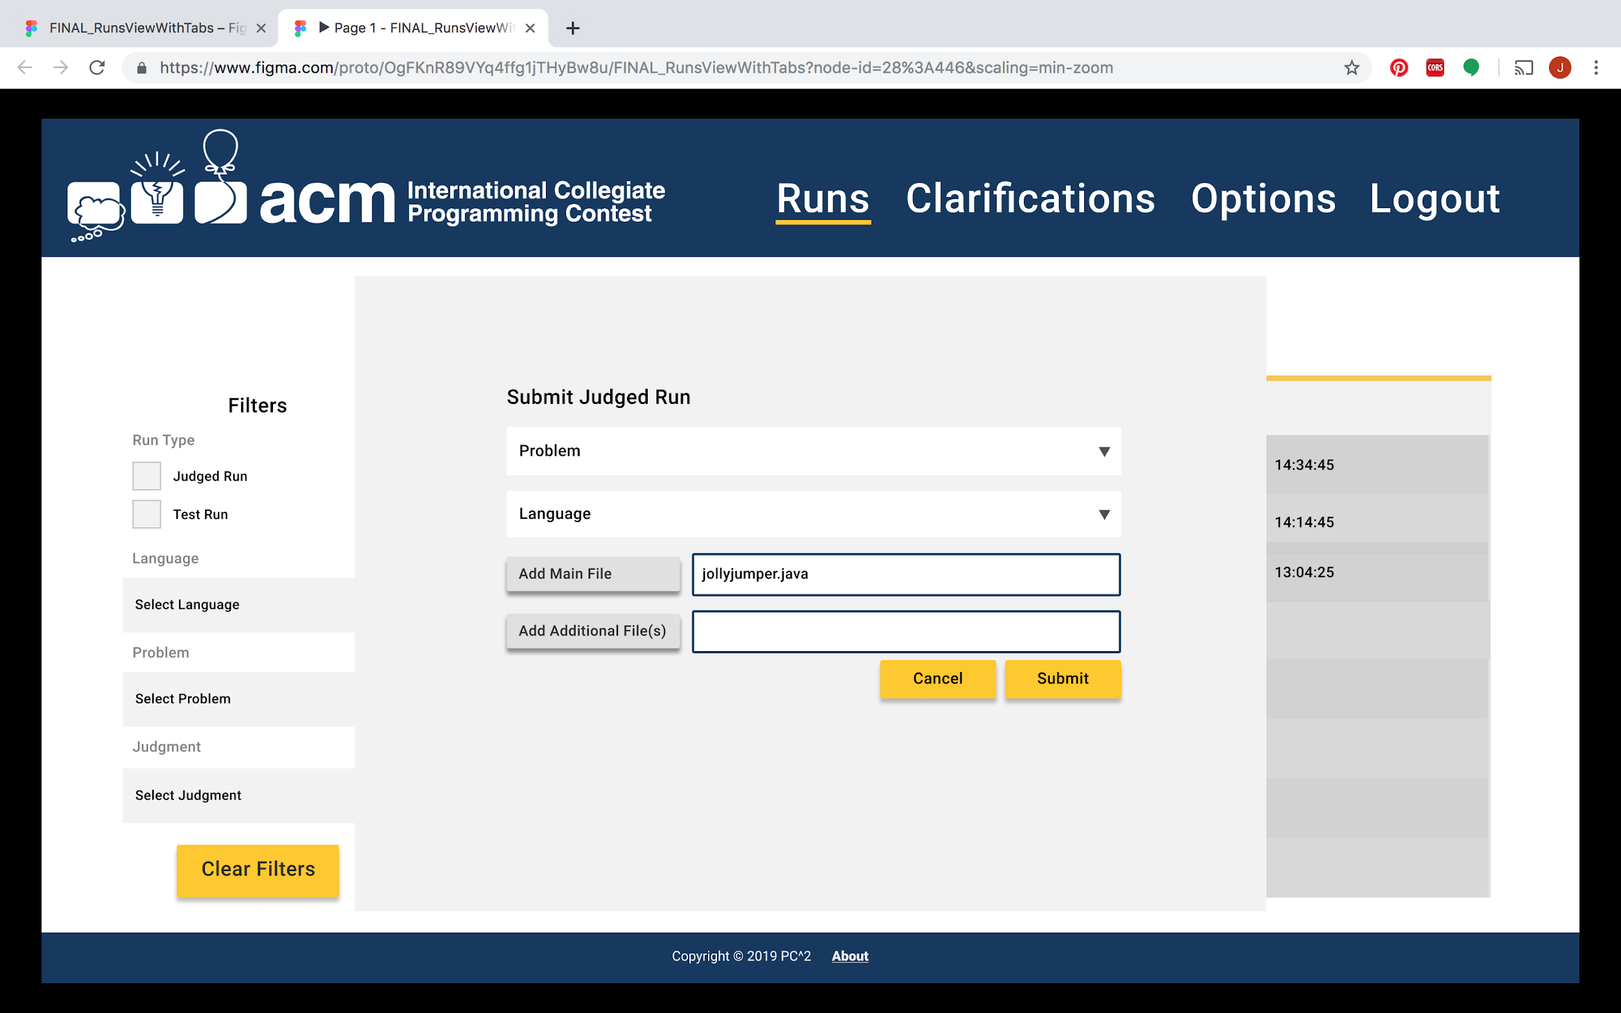

Slide 9
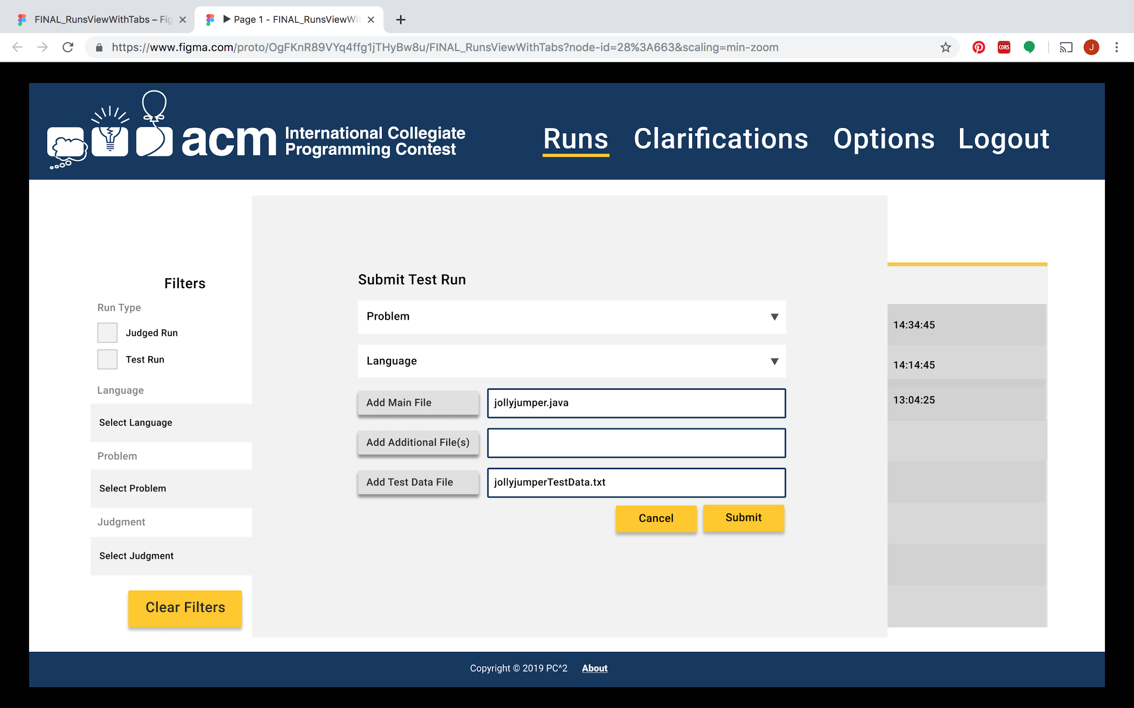

Slide 10
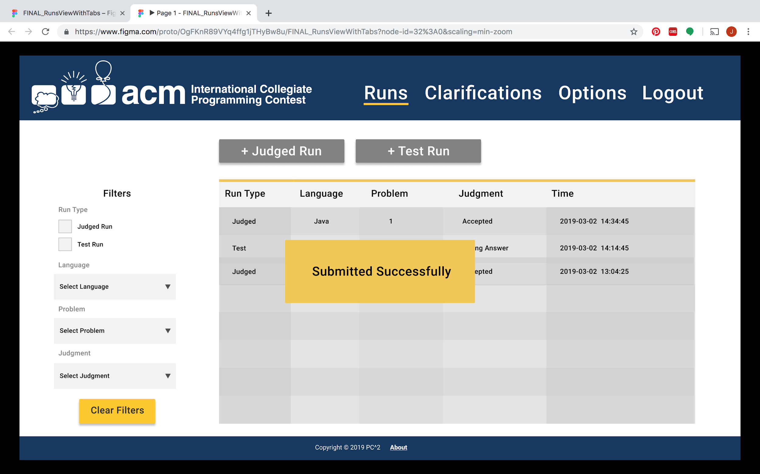

Slide 11
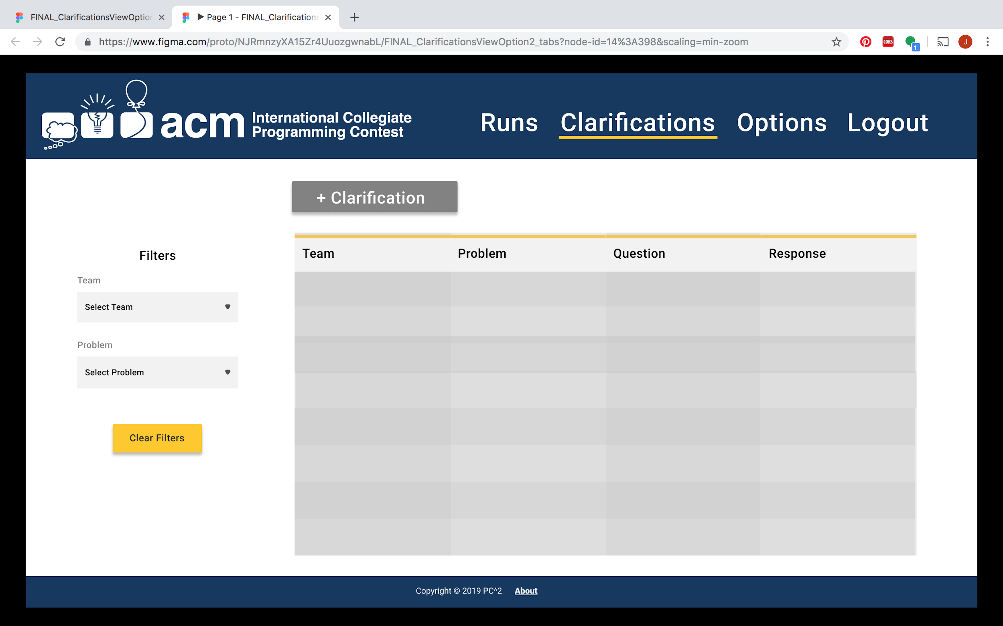

Slide 12
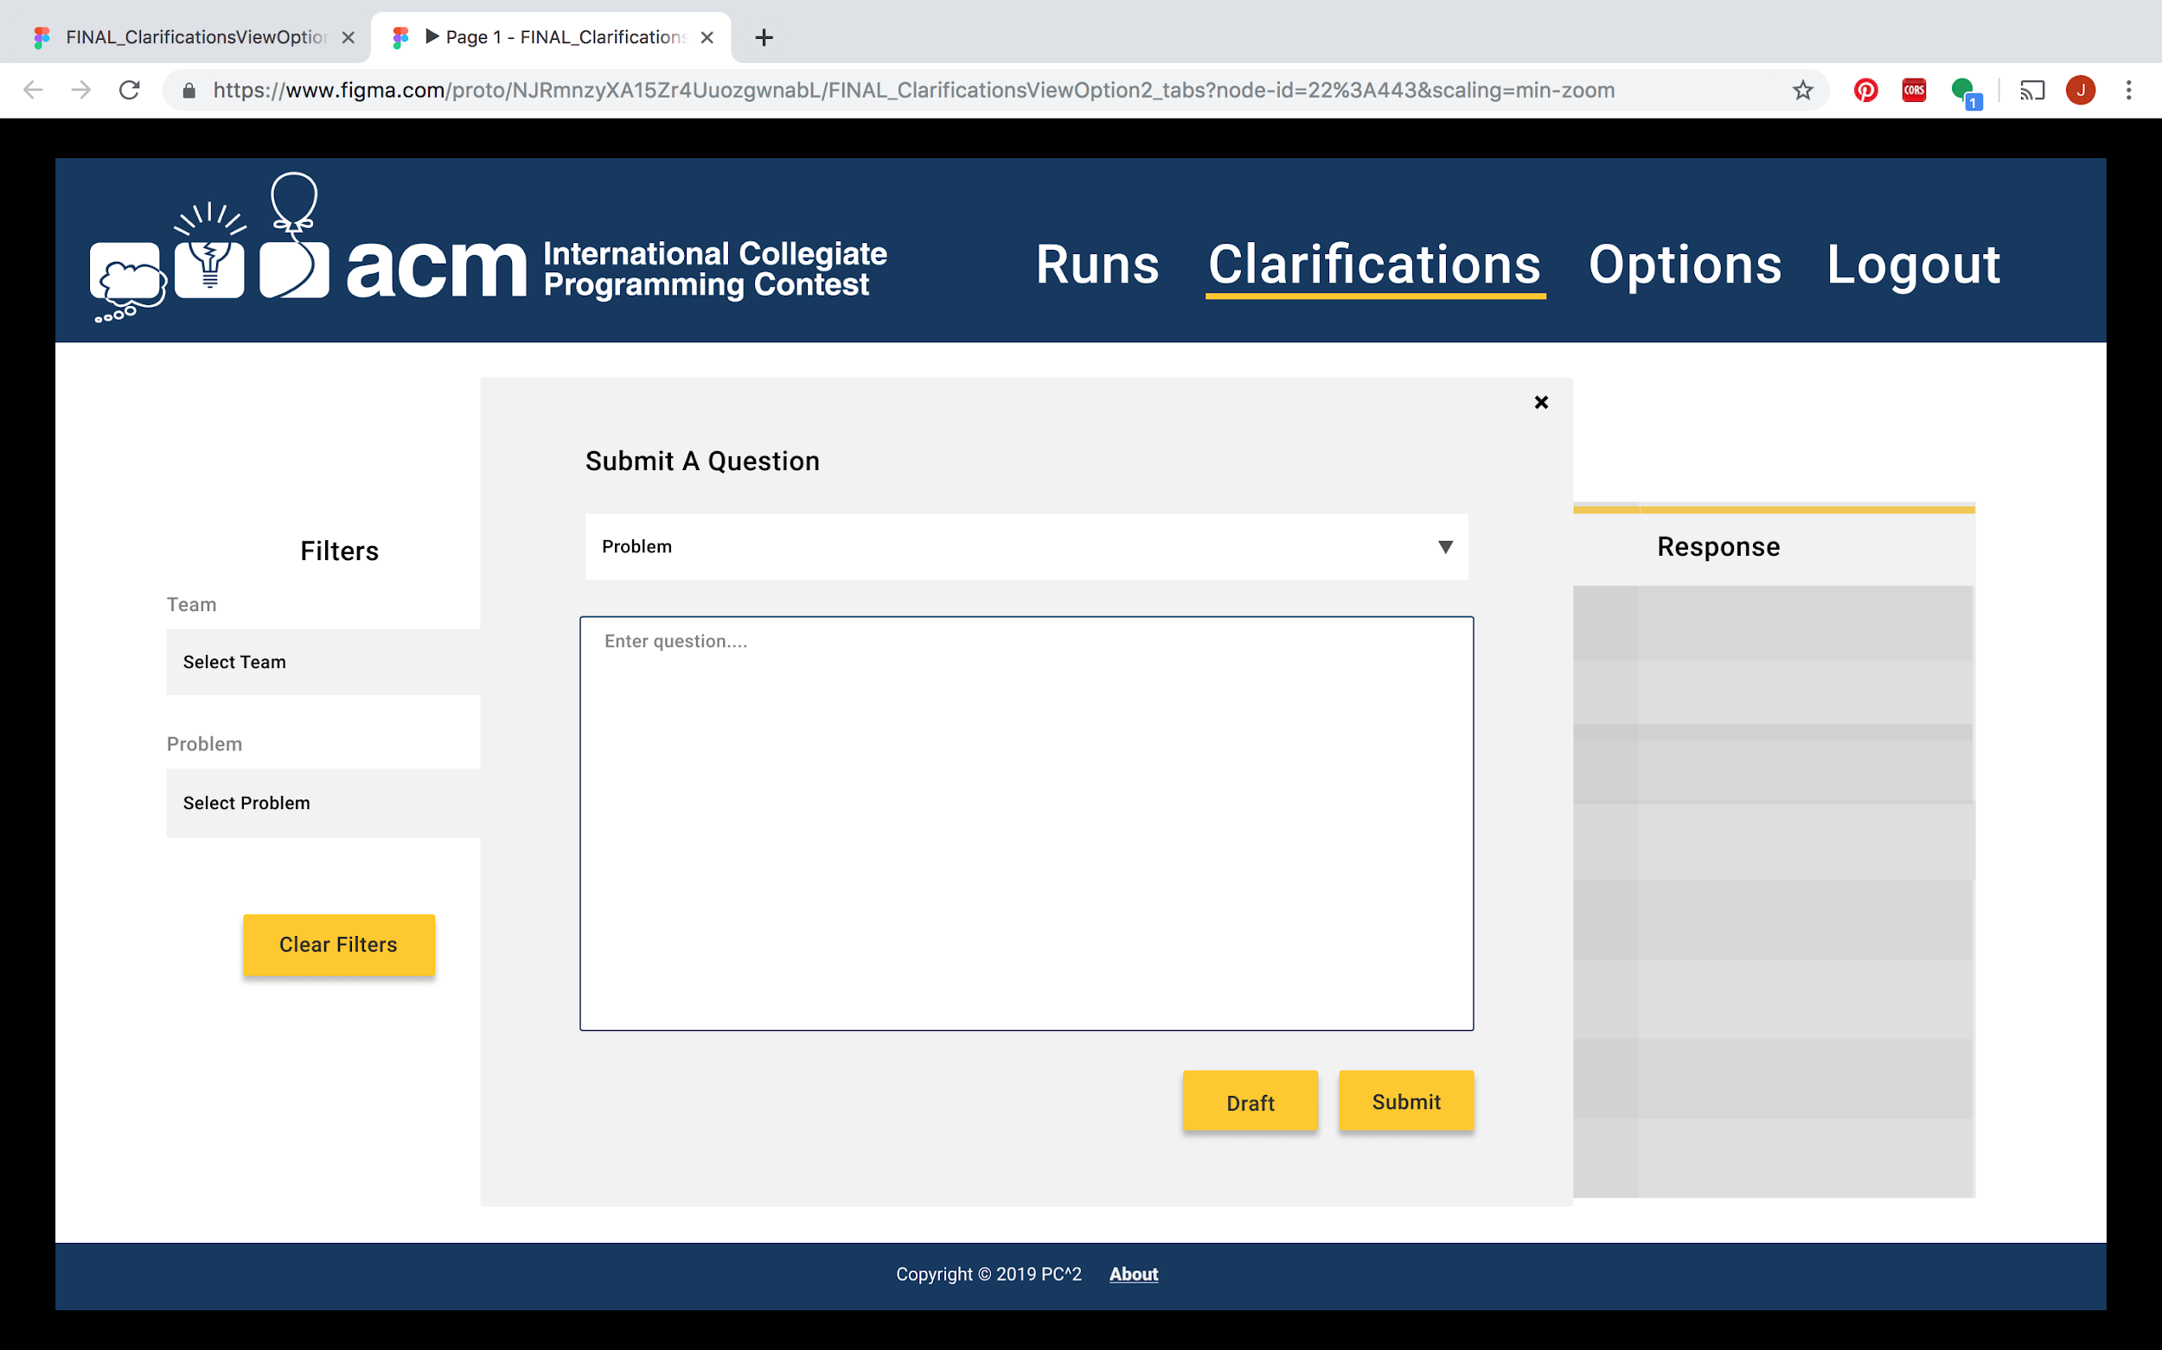

Slide 13
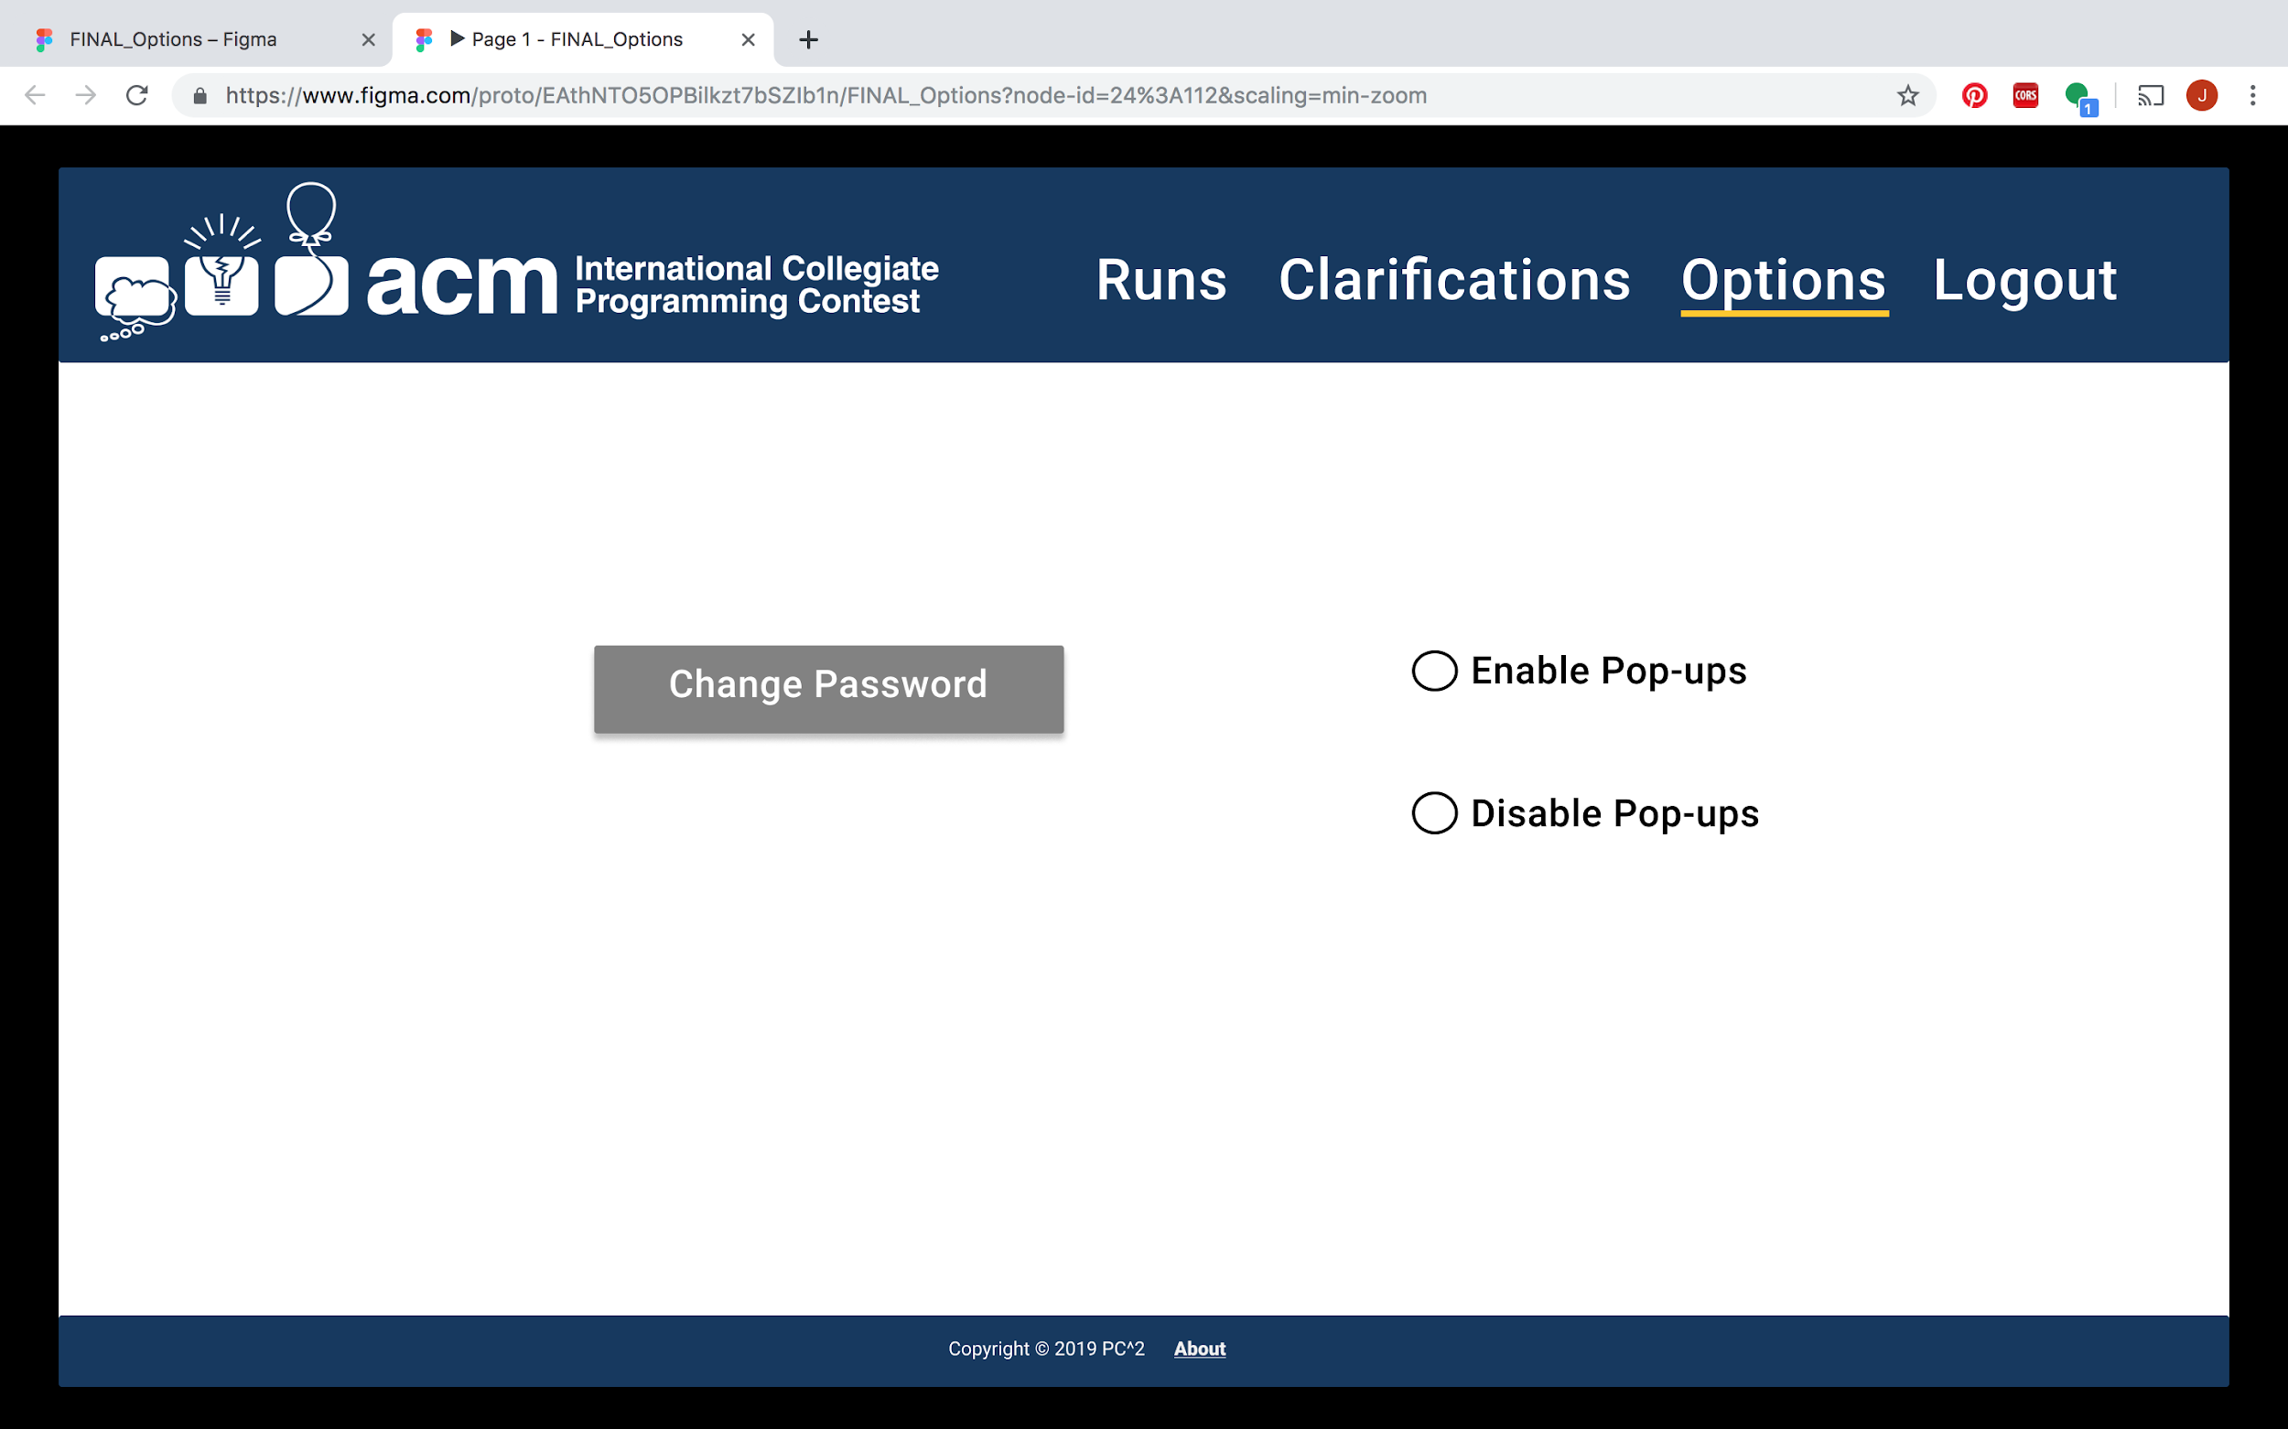

Slide 14
Demo Login Page Functionality

